Slide 1
IPL Visualization
Assignment

Slide 2
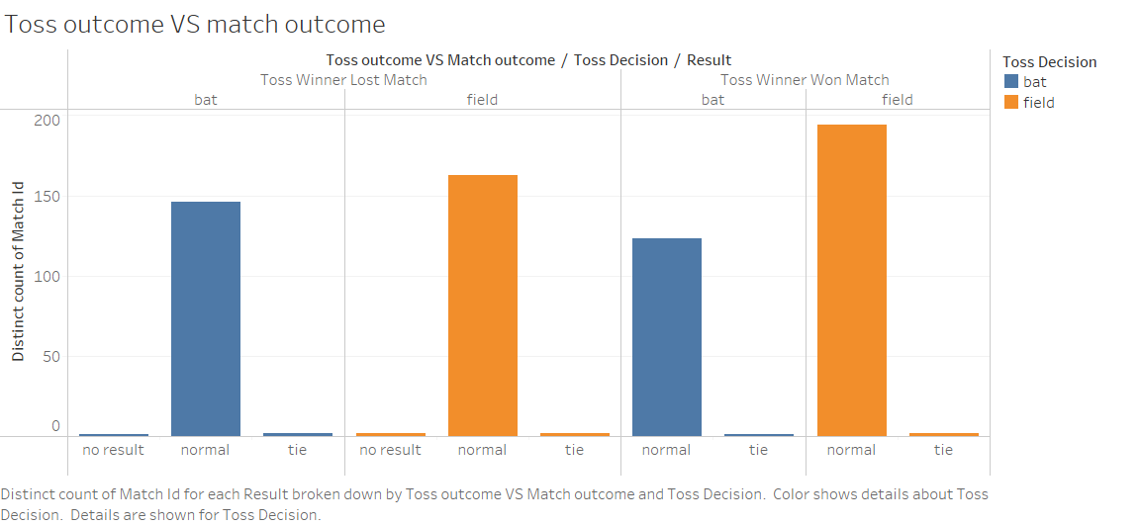
Toss outcome vs match outcome:

Slide 3
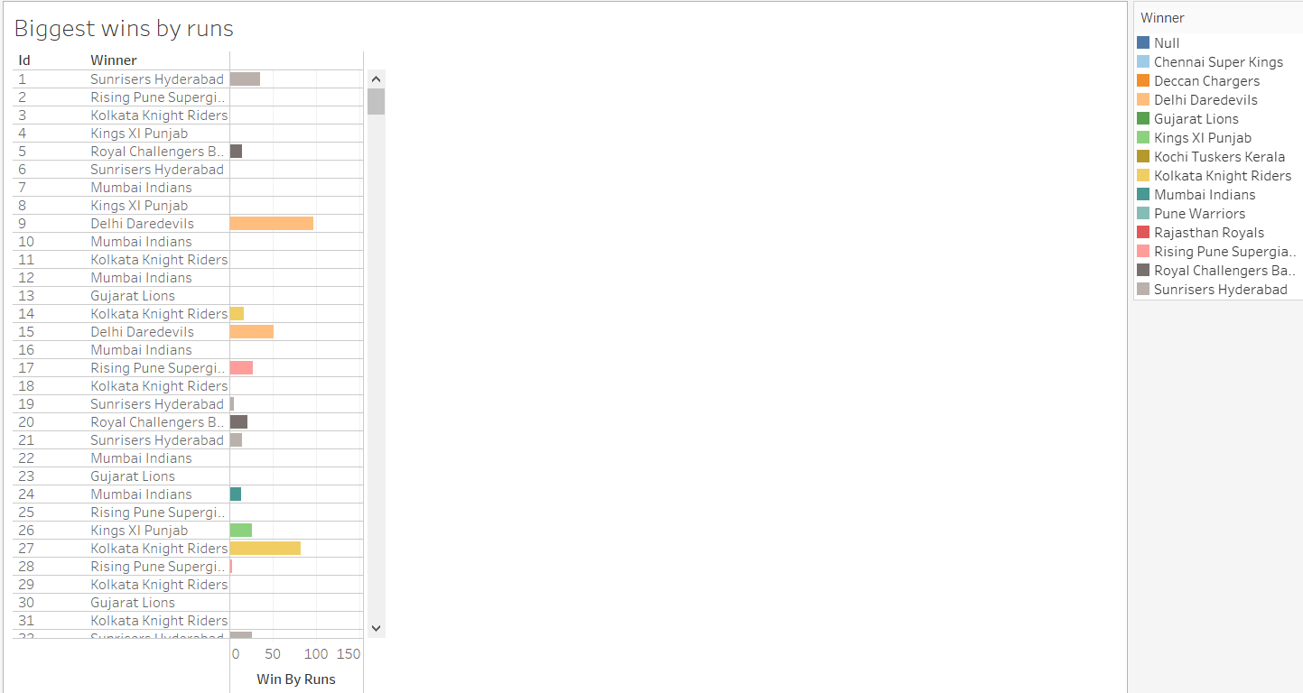
Biggest wins by runs:

Slide 4
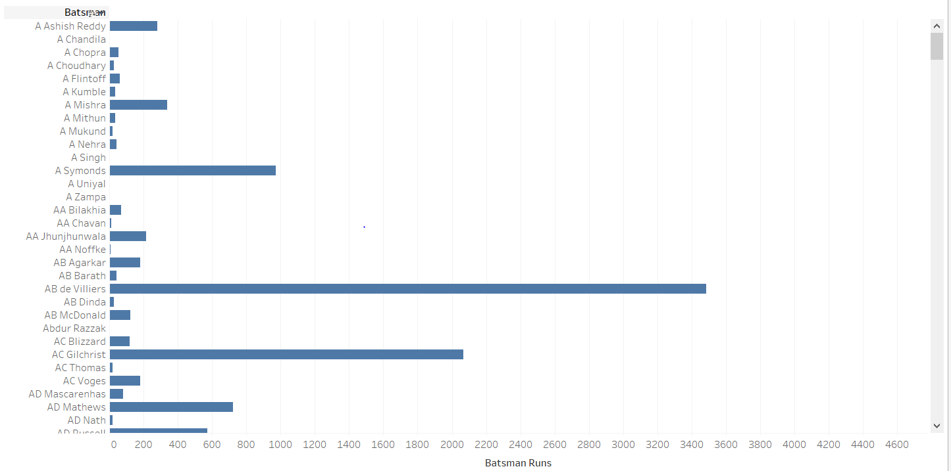
Highest scorers

